Slide 1
Investment Opportunities in Public infrastructure and Public Service Infrastructure – ProInversion
(State Initiatives and Unsolicited proposals projects)
2016- 2018
Updated on November 28, 2016

Slide 3
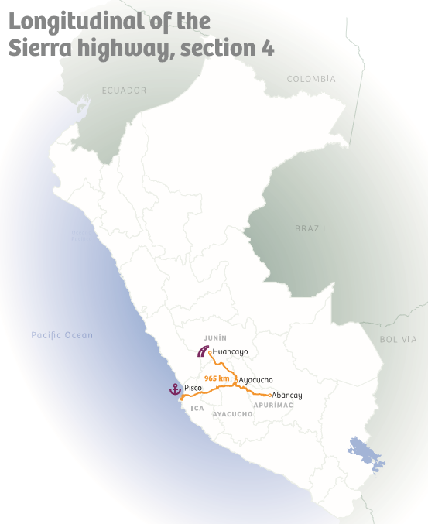
LONGITUDINAL DE LA SIERRA HIGHWAY, SECTION 4
CALLED
Execution of upgrade and rehabilitation works (117 Km), initial periodic maintenance (503 Km); and subsequent maintenance and operation of the 970 Km highway, of this important national highway connecting 12 departments and runs the Andean regions from end to end.
  Projected Investment(w/o VAT ): US$ 446 million
  Does not include routine and periodic operation and maintenance
  Type of concession : Co-financed PPP
  Concession period: 25 years
Estimated award date: Q I 2017
Notes:
3
3

Slide 4
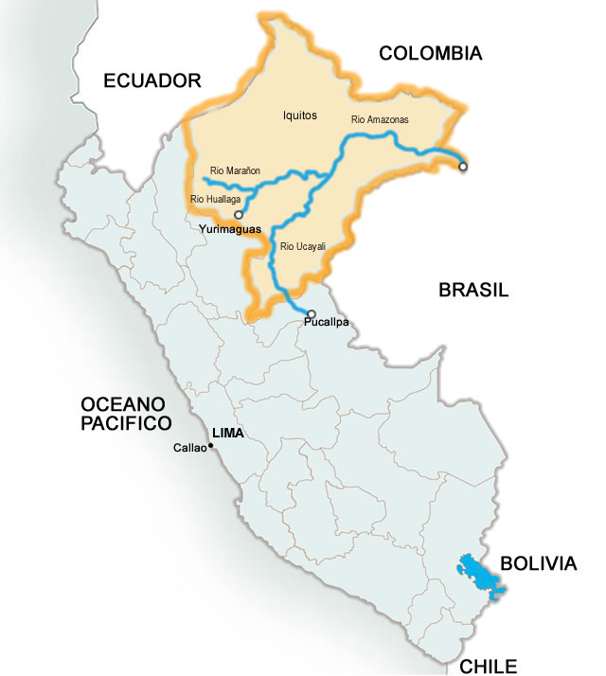
THE AMAZON WATERWAY
CALLED
Loreto
Works and actions to improve navigability on the Amazonas, Marañón, Huallaga and Ucayali rivers: More than 2500 km along this 4 amazon rivers.
    Projected Investment (w/o VAT ): US$ 70 million
    Type of concession: Co-financed PPP
    Concession period: 20 years
Estimated award date: Q I 2017
Ucayali

Slide 5
HUANCAYO - HUANCAVELICA RAILWAY
CALLED
The project comprised the comprehensive rehabilitation of the 128 Km of the existing railway.
    Railway upgrade
    Purchase of rolling stock
    Reinforcement of 15 railway bridges
    Extension of 38 tunnels
    Upgrades to signaling and telecommunication systems
    Draining works
  Projected Investment (w/o VAT ): : US$ 204 million
  Type of concession: Co-financed PPP
  Concession Period: 30 years
  Estimated award date: Q I 2017
Junín
Huancavelica
Central Railway
Huancayo – Huancavelica Railway
South Railway

Slide 6
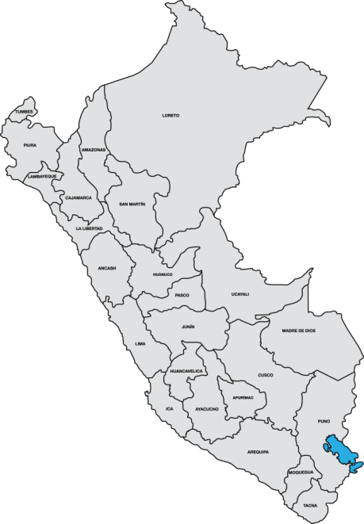
PANAMERICANA SUR HIGHWAY : ICA- DV. QUILCA SECTION
UNDER EVALUATION
Unsolicited proposal for the concession of the construction, operation and maintenance of infrastructure works on the South Panamericana Highway, Ica – Detour Quilca section (Department of Arequipa), with an approximate length of 518 Km.
  Projected Investment : Under evaluation
  Type of concession: Self-financed Unsolicited proposal.
Estimated award date: Q III / IV 2017
  Ica
  Arequipa
Notes:
6
6

Slide 7
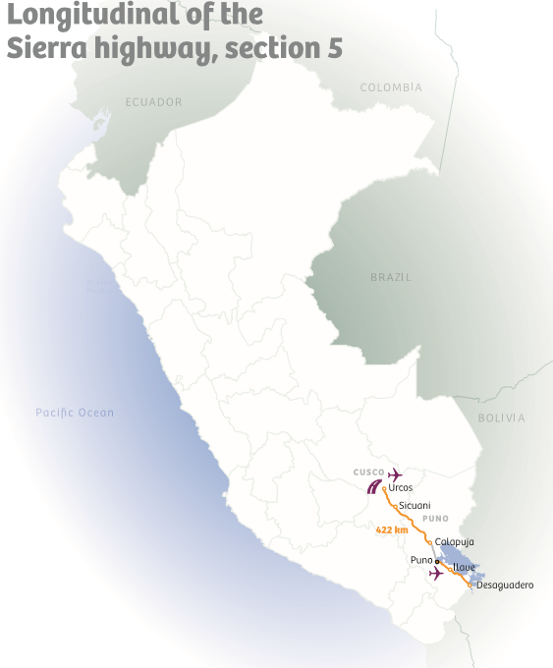
LONGITUDINAL DE LA SIERRA HIGHWAY, SECTION 5
TO BE CALLED
  Initial periodic maintenance, operation and maintenance of 422 Km of the road that links Cusco with Puno.
  Projected Investment : Under evaluation
  Type of concession : Co-financed PPP
Estimated award date: To be defined
Notes:
7
7

Slide 8
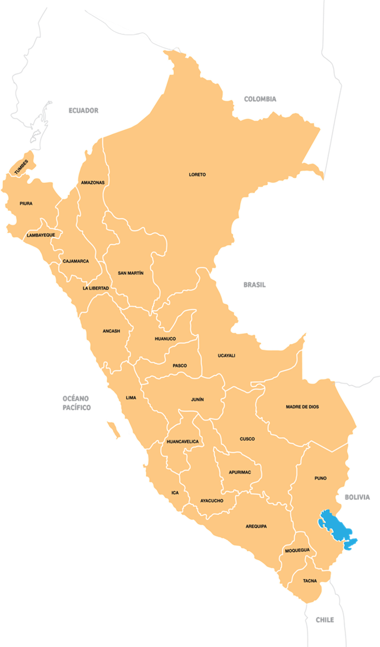

PORT TERMINALS
UNDER EVALUATION
  Self-financed unsolicited proposals:
  Salaverry: Upgrading and development of Salaverry multipurpose terminal.
  Foreseen date for the publication of the declaration of interest: Q I 2017
  2. Ilo: Development and operation of Ilo multipurpose terminal.
  Foreseen date for the publication of the declaration of interest : Q I 2017
Salaverry
Ilo

Slide 9
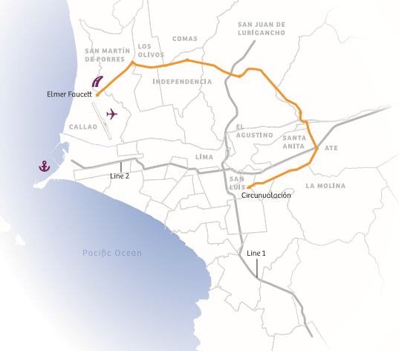
8. ANILLO VIAL PERIFÉRICO DE LIMA METROPOLITANA Y EL CALLAO
UNDER EVALUATION
Unsolicited proposal for the construction, financing, operation and maintenance of a 33 kilometers ringroad expressway, from northwest to southeast Lima.
    Type of concession: Co-financed PPP
  Foreseen date for the publication of the declaration of interest: Q I 2017
  Estimated award date: Q IV 2017
Lima y Callao
Trazo anillo vial

Slide 10
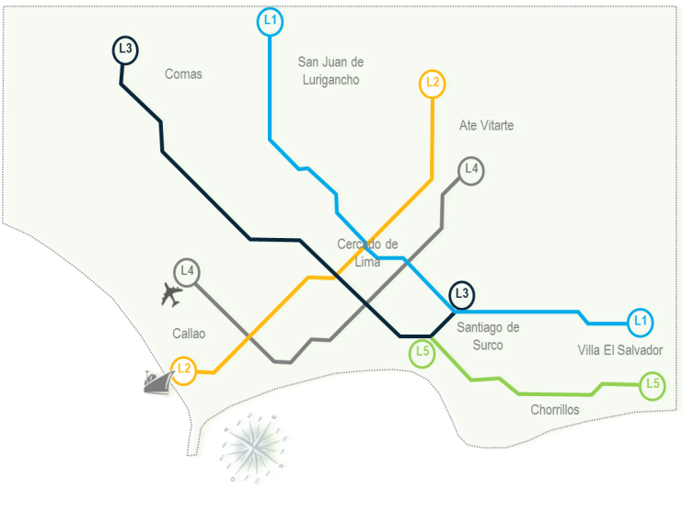
  LINES 3 AND 4 OF THE METRO OF LIMA AND CALLAO
TO BE CALLED
Line 3
Comprehensive Project Bid (DFBOT) through two independent bids, for Line 3 and 4 of the network of the metro of Lima and Callao for the design, financing, construction, equipment, operation and maintenance, which will serve a 3.5 million of a total of 10 millions of inhabitants.
    Projected Investment : Under evaluation
    Type of concession: Co-financed PPP
Line 4
Line 3 | Line 4
32 Km | 30 Km
TO BE DEFINED
Approximated length
Lima and Callao
Estimated award date
Line 1: Under Operation
Line 2: Under Construction
Notes:
10
10
Line 3
Next week, the Committee will approve Reference Terms to engage the services of a transaction advisor. Studies are expected to take 2 years.
Line 4
Reference Terms to engage the services of a transaction advisor have not been prepared yet.

Slide 12
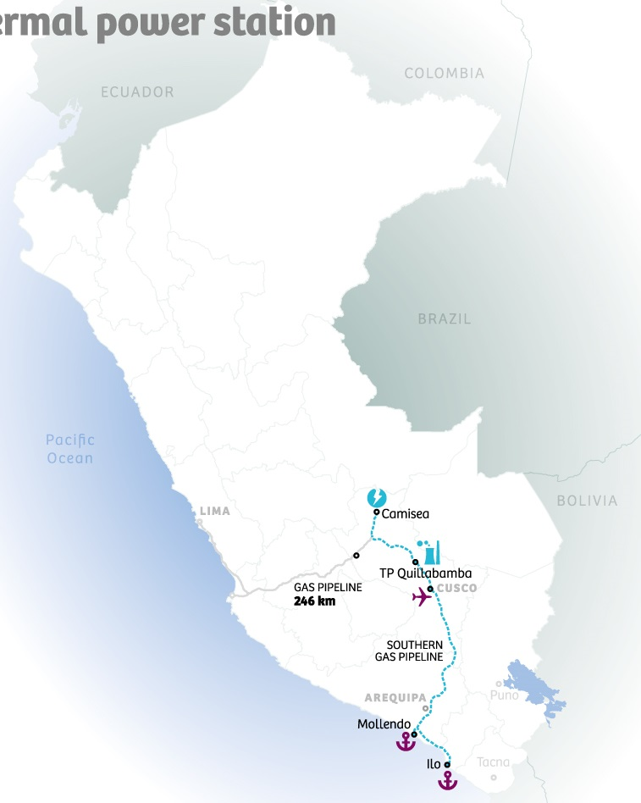
QUILLABAMBA THERMAL POWER PLANT
CALLED
Concession for the design, financing, construction and operation of a 200 Mw thermal power plant (simple cycle) to be located in Quillabamba (department of Cusco) which shall begin operations in 2017 and be connected to The National Electric Power Grid (SEIN)
  Projected Investment (w/o VAT ): US$ 180 million
    Type of concession: Self-financed PPP
    Concession period: 20 years
Estimated award date: To be defined
Notes:
Sistema Eléctrico Interconectado (SEIN)
National Electric Power Grid (SEIN)

Slide 13
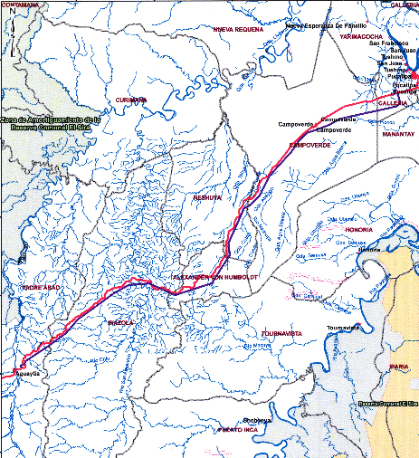
AGUAYTÍA – PUCALLPA 138 KV ELECTRIC TRANSMISSION LINE
CALLED
Concession to design, finance, build, operate and provide maintenance to an electricity transmission line measuring 132 km long, approximately and with a 80 MVA capacity. The aim is to strengthen supply to the Pucallpa Sub-station, which presently has trouble meeting the rising demand focused on this sub-station. Once this new circuit starts operating in parallel with the current one with the same capacity will provide a greater power transmission capacity and reliability in the power supply from Sub-station Pucallpa.
  Projected Investment (w/o VAT ): US$ 20.3 million
    Type of concession: Self-financed PPP
    Concession period: 30 years plus the construction period (33 months)
  Estimated award date: Q I 2017

Slide 14
HYDROCARBONS

Slide 15
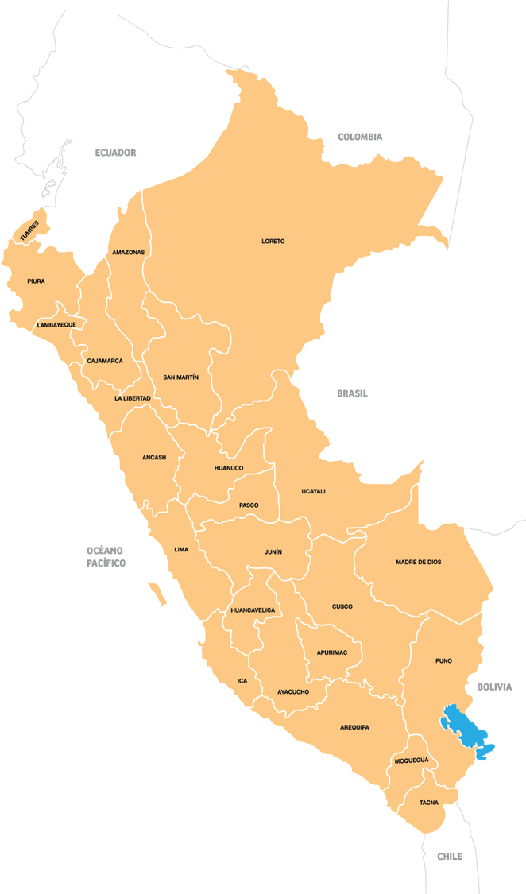
MASS USE OF NATURAL GAS FOR THE CENTER AND SOUTH OF PERU
CALLED
Concession for the design, financing, construction, operation and maintenance of the Gas Natural Distribution System by pipelines network in 07 regions of Peru:
Junín 5. Apurimac
Ucayali 6. Cusco
Huancavelica 7. Puno
Ayacucho
2
1
  Projected Investment (w/o VAT ):US$ 350 million
  Type of concession : Self-financed PPP
  Concession period: 32 years
  Estimated award date: To be defined
6
3
4
5
7

Slide 17
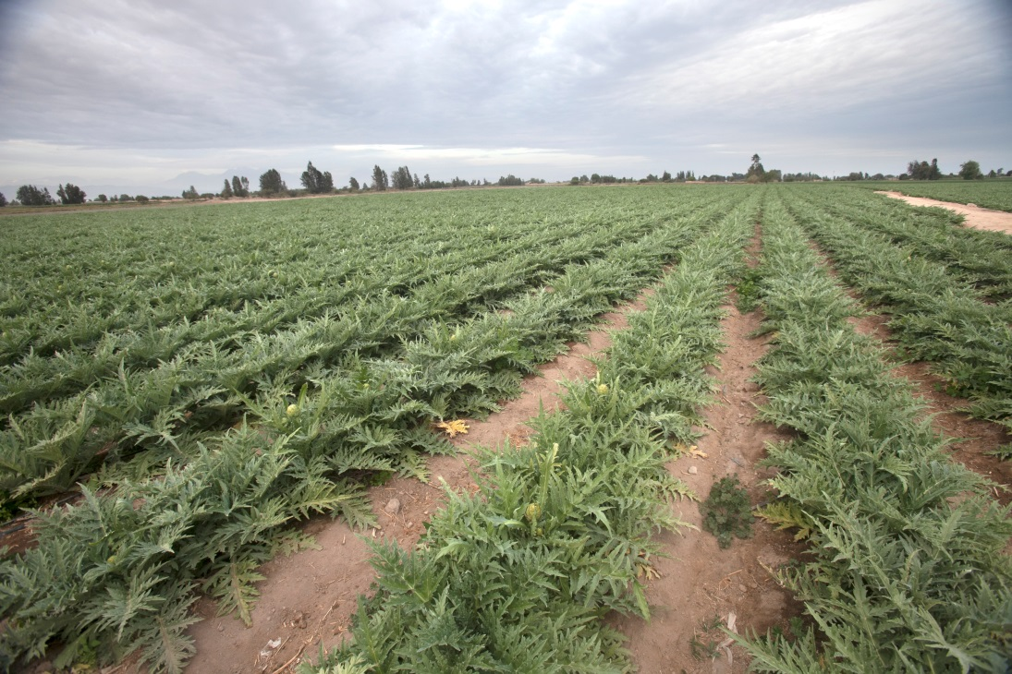
AUCTION OF AGRICULTURAL LANDS -
CHAVIMOCHIC PROJECT
TO BE CALLED
Initial auction of 17,000 hectares of agricultural land of the Chavimochic project, located in the department of La Libertad with an irrigation water to be provided by the project’ concessionaire.
  Base price : US$ 5000 /ha
  Modality: Public auction*
Foreseen auction: II Semester 2017
*Commitment of subscription of water supply contracts with the concessionaire

Slide 19
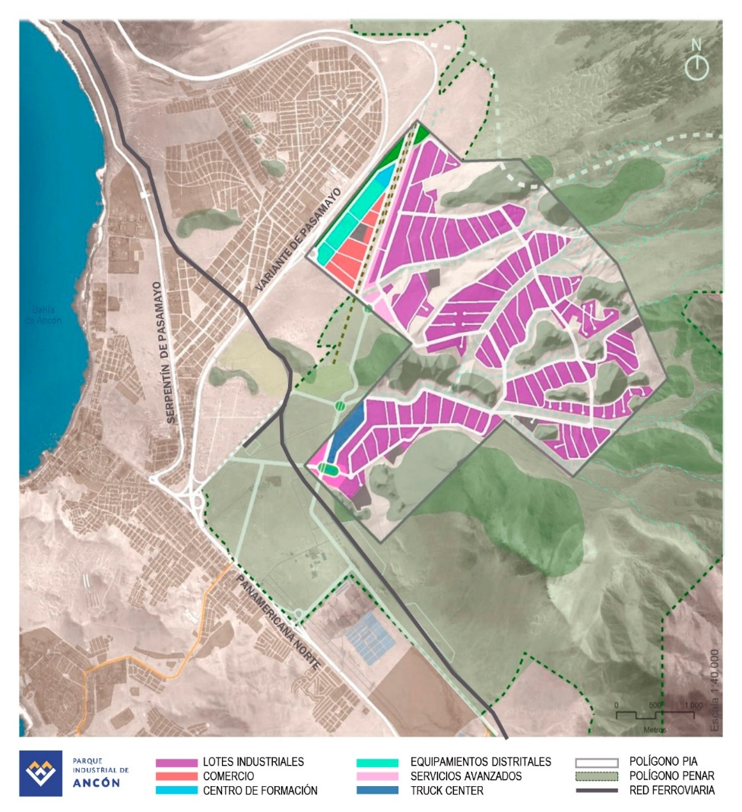
ANCÓN INDUSTRIAL PARK (AIP)
TO BE CALLED
The AIP project consists of developing a modern area for industrial businesses of different sizes in Metropolitan Lima, operating under international standards, promoting efficient and collaborative interaction between different agents related to production but a reference for innovation, trendiness, technology, sustainability, entrepreneurship and development.
    Projected Investment : USD 500 million aprox
    Type of concession: Asset Transfer with investment commitment.
    Concession period: 15 years
    Estimated award date: Q IV 2017

Slide 20
SANITATION
AND HEALTH

Slide 21
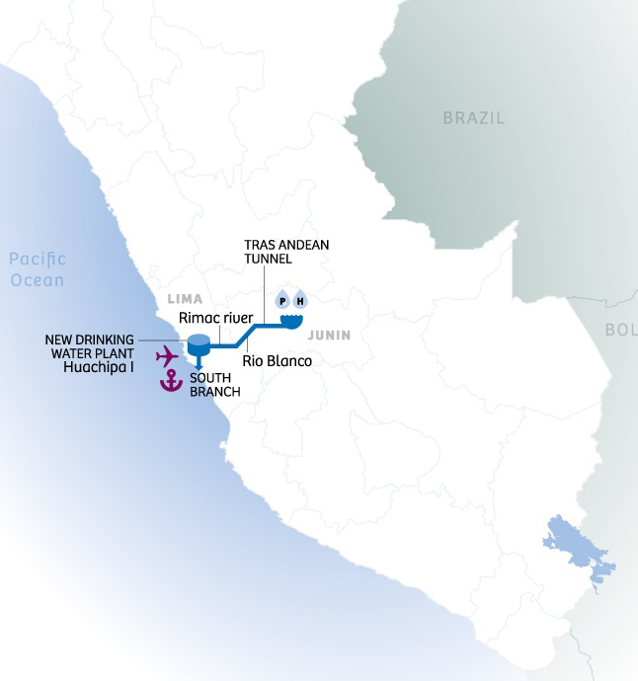
MAIN WORKS AND CONDUCTION OF DRINKING WATER SUPPLY FOR LIMA
Concession for the design, financing, construction, operation and maintenance of the following infrastructure:
Re-enlargement of two dams
Trans-Andean tunnel (about 10 Km)
New drinking water plant Huachipa II (5 m³/s)
South branch pipeline (about 40 Km), including seven reservoirs (total storage volume: 49,000 m³)
Interconnection lines (90 Km approx) with the current drinking water supply system.
The concession also includes the operation and maintenance of the following facilities:
Huachipa Intake (12 m³/s)
Huachipa I drinking water plant (5 m³/s)
North branch pipeline (27.1 Km), including four compensation reservoirs (total storage volume: 23,000 m³ )
  Projected Investment (w/o VAT): US$ 600 million
  Type of concession : Self-financed PPP
  Concession period: 30 years
Estimated award date: Q II 2017
TO BE ANNOUNCED
CALLED

Slide 22
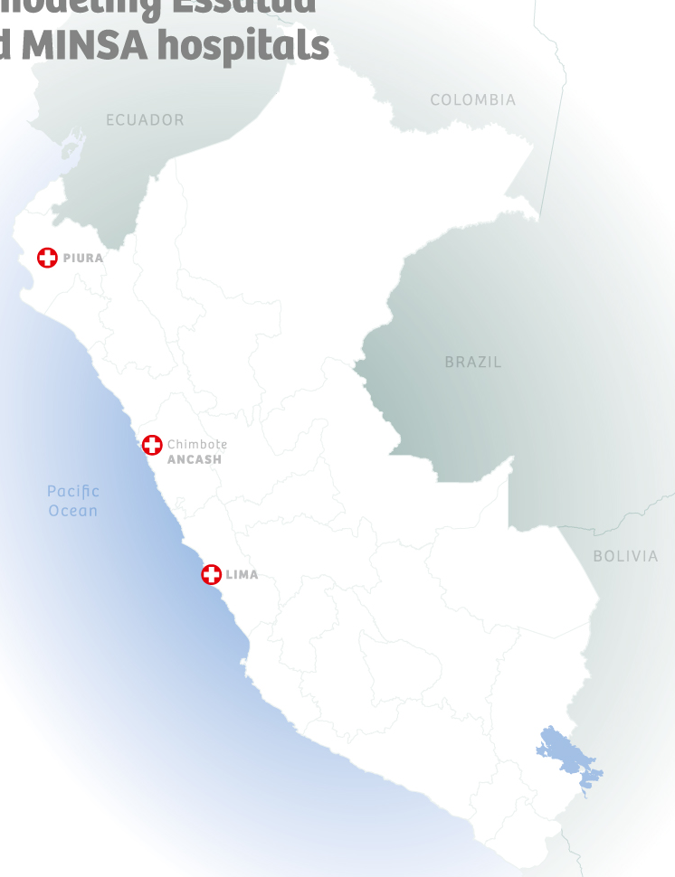
THREE NEW HIGH-COMPLEXITY HOSPITALS
TO BE CALLED
Concession of the design, construction, equipment, operation and maintenance of complementary services in three high-complexity hospitals in the Peruvian Social Security System (ESSALUD)
  Projected Investment : US$424 million
  Type of concession: Co-financed PPP
  Estimated award date: Q III 2017
Piura
Ancash
Lima

Slide 23
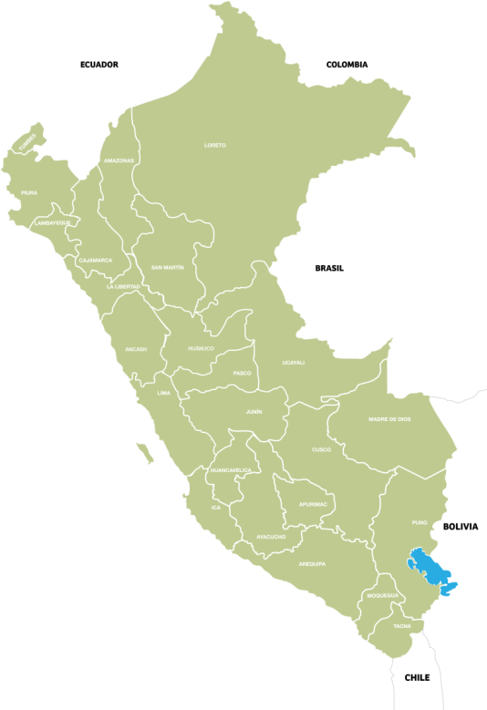
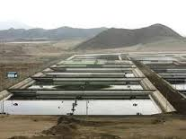
Water Treatment System for Titicaca Lake basin
UNDER EVALUATION
Unsolicited proposal consisting in the development of a solution for the treatment and final disposal of municipal wastewater in the Titicaca Lake basin in Puno.
  Type of concession: Co-financed PPP
  Projected Investment : Under evaluation
  Foreseen date for the publication of the declaration of interest : Q II 2017
Puno

Slide 25
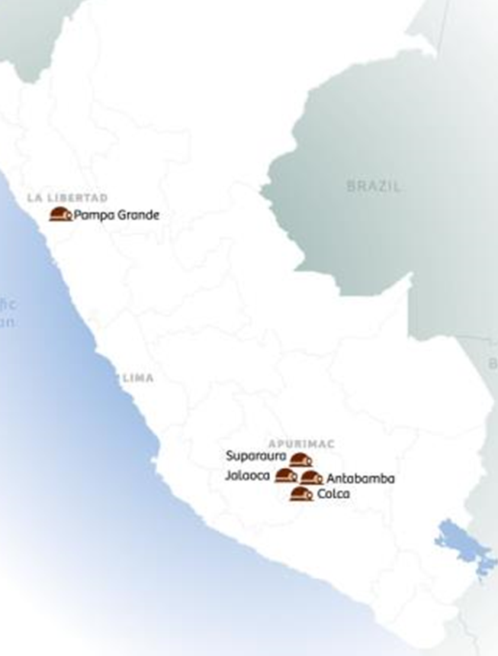
04 MINING EXPLORATION PROJECTS
TO BE CALLED
Investment Projects under the modality of transfer contract for a period of 3 to 4 years for the exploration and feasibility study of the following prospects:
Apurímac:
Colca: Cu, Mo, Ag, Au, Pb Q II 2017 14,100ha
Jalaoca: Cu, Mo, Ag, Au, Pb Q III 2017 6,400 ha
Antabamba: Cu, Mo, Au, Zn Under evaluation 19,200 ha
La Libertad
Pampa Grande: Au, Ag Under evaluation 8,700 ha
Estimated Award
Area
  Type of concession: Assets transfer
  Projected Investment : Under Evaluation

Slide 26
www.proinversion.gob.pe

