Slide 1
WHY INVEST IN PERU?
December 6, 2016

Slide 2
WHY INVEST IN PERU?
Internationally acknowledged macroeconomic soundness
Friendly investment environment
Trade integration policy – market access
4. Attractive sectors to Invest
Notes:
Sin duda la crisis financiera internacional afecta las perspectivas de inversión en el mundo y lleva a los expertos a evaluar los proyectos propuestos con mayor cuidado, lo cual no implica que las empresas puedan dejar de pensar en sus desarrollos de largo plazo.
En este contexto, el Perú destaca como un destino de inversión que vale la pena evaluar. Las razones se pueden resumir en 4 campos básicos:
Estabilidad macroeconómica: la economía peruana presenta excelentes resultados siendo uno de los países mejor preparados para enfrentar la crisis global.
Clima favorable para la inversión: el país ha consolidado uno de los marcos legales más modernos y atractivos para la inversión extranjera responsable.
Acceso a mercados: el Perú ha establecido una amplia red de acuerdos comerciales que le aseguran acceso preferente a prácticamente todos los mercados más dinámicos del mundo.
Desarrollo de infraestructura: el crecimiento exponencial del comercio internacional peruano está generando un sustantivo aumento de la demanda por infraestructura y servicios logísticos. En ese sentido el Estado peruano viene desarrollando obras de infraestructura de importante magnitud en las cual promueve la participación del sector privado. Ello permitirá elevar nuestra competitividad y proyectarnos como una eficiente plataforma productiva y comercial en el Pacífico Sudamericano.
2

Slide 3
MACROECONOMIC SOUNDNESS

Slide 4
MACROECONOMIC SOUNDNESS
Peruvian economy grew rapidly in the last decade …
Real GDP, 2004-2016*
(%Variation)
GDP, 2004-2016*
(US$ Billion)
Source: Central Reserve Bank of Peru , International Monetary Fund
Estimated figures of BCRP (Inflation report as of September, IMF (World Economic Outlook Database – October 2016)

Slide 5
MACROECONOMIC SOUNDNESS
… and continues leading regional growth allowing the GDP per capita to exceed the global average by 2020…
Real GDP – Forecasts for Latin America 2016-2017
(Annual Average Variation %)
GDP per capita, PPP
($ International constant prices of 2005)
Peru
Peru
Latin-American and Caribe
World
Source: IMF / * in Peru case, source: BCRP

Slide 6
MACROECONOMIC SOUNDNESS
ESTABILIDAD MACROECONÓMICA
MACROECONOMIC STABILITY
Economic growth has been driven by an increase in private investment…
Private Investment 2004-2016*
(Variation %)
Private Investment 2004-2015
(US$ Billion)
Source: BCRP
* BCRP Estimated figures (Inflation report as September 2016)

Slide 7
MACROECONOMIC SOUNDNESS
ESTABILIDAD MACROECONÓMICA
MACROECONOMIC STABILITY
… which today represents almost 20% of GDP …
Private Investment 2004-2016*
(% of GDP)
Total investment – LATAM 2015
(% of GDP)
Colombia Peru Chile Mexico Brazil
Private Investment
Public Investment
Source: Central Reserve Bank of Peru
* Estimated figures of BCRP (Inflation report as of September 2016)
Source: International Monetary Fund and figures of Central Reserve Bank

Slide 8
MACROECONOMIC SOUNDNESS
ESTABILIDAD MACROECONÓMICA
MACROECONOMIC STABILITY
Investment announcements
Announcement of Private Investment projects 2016 - 2018
(US$ million )
 | Total Investment
Mining | 8,911
Hydrocarbons | 4,821
Electricity | 3,985
Industry | 2,240
Infrastructure | 5,028
Other Sectors | 8,142
Total | 33,127
Source: BCRP Inflation report, September 2016)

Slide 9
MACROECONOMIC SOUNDNESS
ESTABILIDAD MACROECONÓMICA
MACROECONOMIC STABILITY
… Peru is an attractive market for foreign investment, which recorded $ 7 billion in 2015
Foreign direct investment flow 2004 – 2016*
(US$ Billion)
Foreign direct investment – LATAM 2015
(% GDP)
Chile Colombia Peru Brazil LAC Mexico
Source: BCRP
* Estimated figures BCRP ( inflation report , September 2016)
Source: IMF and UNCTAD

Slide 10
MACROECONOMIC SOUNDNESS
Furthermore, the domestic demand is strengthening …
Real domestic demand 2004–2016*
(real annual Var. % )
Imports of vehicles
for private use
(US$ million)
Imports of domestic assets /1
(US$ million)
3 Times
7 Times
Source: Central Reserve Bank of Peru and MEF
Estimated figures BCRP (Inflation report, September 2016)
Source: SUNAT
1/ Includes imports of machines and appliance. Furniture and other house equipment's

Slide 11
MACROECONOMIC SOUNDNESS
ESTABILIDAD MACROECONÓMICA
MACROECONOMIC STABILITY
This is complemented by a dynamic commercial trade…
Balance of Trade 2004-2016*
(US$ million)
Exports
Imports
Trade Balance
Source: BCRP
* Estimated figures BCRP ( Inflation report, September 2016)

Slide 12
MACROECONOMIC SOUNDNESS
... all this, in a frame of macroeconomic stability, Peru records the lowest inflation rate at a regional level….
CPI – Latin America 2005- 2015
(Annual Average Variation %)
CPI – Latin America 2015
(Annual Average Variation %)
Peru Chile Mexico Colombia Brazil
Brazil
Mexico Peru Chile Colombia Brazil
Source: Central Bank of Reserve of Peru,IMF (World Economic outlook Database – October 2016

Slide 13
MACROECONOMIC SOUNDNESS
… has maintained stable exchange rates and a level of risk under the regional average
Exchange Rate in Latin America 2004-2016 (*)
(Index, Base year 2005 = 100)
JP Morgan EMBI+
(Basic points)
Spread Peru (pbs)
Peru
Mexico
Brazil
Spread LATAM (pbs)
(*) As of August 2016
Source: CEPAL
Source: BCRP

Slide 14
MACROECONOMIC SOUNDNESS
Peru maintains a healthy level of debt…
Public Debt– Peru 2004-2016*
(% of GDP)
Public Debt– Latin America 2015
(% of GDP)
Source: Central Bank of Reserve of Peru
*Estimated figures, BCRP (Inflation report September 2016)
Source: IMF; and Peru figures source BCRP

Slide 15
MACROECONOMIC SOUNDNESS
… and has accumulated international reserves for a third of the GDP
Net International Reserves
( US$ Billion)
NIR Adequacy Indicators
 | 2006 | 2011 | 2016*
NIR (% del GDP) | 19.6 | 28.6 | 32.4
NIR (% short -term foreign debt) | 166 | 471 | 580
RIN (% Short-term Foreign Debt plus Current Account deficit) | 230 | 360 | 346
Source: Central Reserve Bank of Peru
*Up to May 31 th, 2016
Source: BCRP. Inflation report June 2016
*Projection

Slide 16
MACROECONOMIC SOUNDNESS
Peru earned the investment grade and investor´s confidence by practicing a responsible political economy
Investment grade
Latin America benchmarking
Country | Moody's | S&P | Fitch
Chile | Aa3 | AA- | A+
Peru | A3 | BBB+ | BBB+
Mexico | A3 | BBB+ | BBB+
Colombia | Baa2 | BBB | BBB
Uruguay | Baa2 | BBB | BBB-
Paraguay | Ba1 | BB | BB
Brazil | Ba2 | BB | BB
Bolivia | Ba3 | BB | BB-
Ecuador | B3 | B | B
Argentina | B3 | B- | B
Venezuela | Caa3 | CCC | CCC
Source: Standard & Poor`s, Fitch Ratings and Moody´s.
Updated as of August 24th, 2016
Notes:
16
En cuanto a la posición externa…
La responsable política económica, que ha mantenido continuidad a través de la sucesión de gobiernos democráticos, ha permitido acumular reservas internacionales que cubren en exceso la deuda externa, fortalecer el sistema financiero (muy baja morosidad), mantener un importante superávit fiscal y reducir el ratio deuda-PBI, lo cual coloca al Perú en mejores condiciones que muchos otros países en el mundo para afrontar el actual escenario de crisis internacional.
Perú ha venido registrando superávit presupuestales por varios años y el nivel de su deuda pública es bajo. De hecho, Perú es uno de los pocos países donde las reservas internacionales del Banco Central (US$ 31 mil millones o 26% del PBI) exceden el total de la deuda pública interna y externa (US$ 30 mil millones).
Finalmente, cabe anotar que ante un escenario de mayor volatilidad, donde aumenta la percepción del riesgo sobre las economías emergentes, el Perú sigue manteniendo un nivel de riesgo país por debajo del promedio regional y ha podido alcanzar (desde julio de 2008) que 3 agencia clasificadoras de riesgo (Standard & Poors, Fitch Ratings y la agencia canadiense Dominion Bond Rating Service) lo posicionen como país con grado de inversión.
En cuanto a la posición externa…
La responsable política económica, que ha mantenido continuidad a través de la sucesión de gobiernos democráticos, ha permitido acumular reservas internacionales que cubren en exceso la deuda externa, fortalecer el sistema financiero (muy baja morosidad), mantener un importante superávit fiscal y reducir el ratio deuda-PBI, lo cual coloca al Perú en mejores condiciones que muchos otros países en el mundo para afrontar el actual escenario de crisis internacional.
Perú ha venido registrando superávit presupuestales por varios años y el nivel de su deuda pública es bajo. De hecho, Perú es uno de los pocos países donde las reservas internacionales del Banco Central (US$ 31 mil millones o 26% del PBI) exceden el total de la deuda pública interna y externa (US$ 30 mil millones).
Finalmente, cabe anotar que ante un escenario de mayor volatilidad, donde aumenta la percepción del riesgo sobre las economías emergentes, el Perú sigue manteniendo un nivel de riesgo país por debajo del promedio regional y ha podido alcanzar (desde julio de 2008) que 3 agencia clasificadoras de riesgo (Standard & Poors, Fitch Ratings y la agencia canadiense Dominion Bond Rating Service) lo posicionen como país con grado de inversión.

Slide 17
FRIENDLY INVESTMENT ENVIRONMENT

Slide 18
FRIENDLY INVESTMENT ENVIRONMENT
Peru offers a favorable legal framework for foreign investment:
Non discriminatory treatment: Foreign investors receive the same treatment as local investors.
Unrestrictive access to most economic sectors *.
Free transfer of capital.
Free competition.
Guarantee for Private Property.
Freedom to purchase stocks from locals.
Freedom to access internal and external credit.
Access to international disputes settlement mechanism
Peru participates in the Investment Committee of the Organization for Economic Co-operation and Development (OECD) – It promotes the implementation of the Guidelines for Multinational Enterprises.
*Investments that require authorization: Located within 50 km in the frontier line and those destined to arms, ammunitions and explosive. Likewise, a principal local partner for investments in maritime cabotage as well as in air transport is required.

Slide 19
FRIENDLY INVESTMENT ENVIRONMENT
Special Regimes: Legal Stability Agreements
Regime whereby the Peruvian Government guarantees:
INVESTORS
Stability of regulations regarding non discriminatory treatment.
Stability of income tax regime applicable to dividends.
Stability to use freely the most favorable exchange rate available in the market.
Stability of the free availability and remittance of foreign currency, dividends and royalties regime.
RECEIVING COMPANY
Stability of the recruitment regimes.
Stability of the regimes for the promotion of exports.
Stability of the Income Tax Regime
Requirement: Minimum investment of US$ 5 million in any economic sectors. US$ 10 million for hydrocarbon and mining sectors.
Validity: 10 years. Concessions: Term according to the contracts life (Max. 60 years).

Slide 20
FRIENDLY INVESTMENT ENVIRONMENT
Special Regime: VAT Anticipated Recovery.
Regime whereby the Peruvian Government grants the following benefits:
Granting the return of the Value Added Tax during the pre-productive stage of the project (minimum 2-year term).
Applicable to all economic sectors
For agricultural activity it is not necessary to meet a minimum investment amount. For other activities the minimum investment amount is US$ 5 million.
The project can be divided into stages, phases or similar.

Slide 21
A steady tax regime:
FRIENDLY INVESTMENT ENVIRONMENT
Tax |  | Applicable Rate
INCOME | Corporate profits | 28.0% (2015-2016) 27.0% (2017-2018) 26.0% (2019 henceforth)
 |  | Agriculture and agribusiness 15%
 | Dividends | 6.8% (2015-2016) 8.0% (2017-2018) 9.3% (2019 henceforth)
 | Royalties | 30.0%
 | Interest rate on loans from abroad | 4.9%
Value Added Tax (VAT) |  | 18.0%
Financial Transactions Tax |  | 0.005%
Temporary to net assets, applicable to the excess of S/. 1 000 000 |  | 0.4%

Slide 22
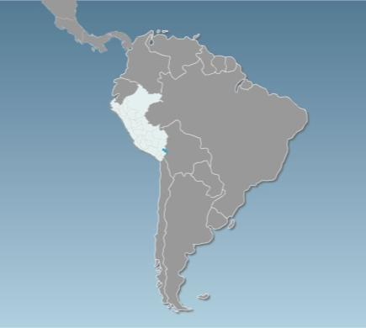
FRIENDLY INVESTMENT ENVIRONMENT
Continuous effort to facilitate the establishment and operation of business
Venezuela
187
Guyana
3rd
in the regional ranking of ease of doing business in Latin America
Colombia
124
53
Surinam
.
Ecuador
158
114
Brasil
Position | Country
1 | Mexico
2 | Colombia
3 | Peru
4 | Chile
5 | Panama
Perú
123
54
Bolivia
Paraguay
149
92
Chile
Uruguay
57
90
Argentina
116
Source: World Bank Doing Business 2017
Notes:
22

Slide 23
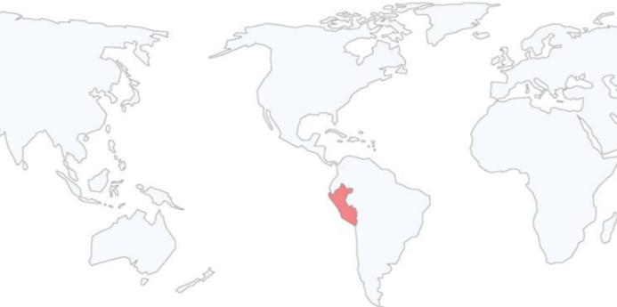
FRIENDLY INVESTMENT ENVIRONMENT
Investment Agreements
Peru has signed and currently has in force Agreements for the Promotion and Reciprocal Protection of Investment and Trade Agreements of further scope that includes investment chapters that underpin our liberalization policy.
European Union ²
European Association of free Trade (Iceland, Liechtenstein, Switzerland and Norway) ¹
Australia
China ¹
Korea ¹
Malaysia
Singapore ¹
Thailand
Japan
Brunei
New Zealand
Vietnam
Canada ¹
United States¹
Mexico ¹
Cuba
El Salvador
Costa Rica ¹
Panama ¹
Argentina
Bolivia
Chile ¹
Colombia
Ecuador
Paraguay
Venezuela
Trade agreements
Trade Agreement. Besides , Peru has Investment bilateral agreements with Germany, Belgium, Luxemburg, Denmark, Spain, Finland, France, Holland, Italy, Portugal, United Kingdom, Check Republic, Sweden and Switzerland.
It has also signed 8 agreements to avoid double taxation with Andean Community, Brazil, Chile, Canada, Korea, Mexico, Portugal and Switzerland.
Notes:
23

Slide 24
TRADE INTEGRATION POLICY - MARKET ACCESS
Notes:
Trade integration policy – market access

Slide 25
OPEN TRADE AND MARKET ACCESS POLICY
An open trade policy sustained over time
Evolution of nominal and effective tariff; and tariff dispersion 1993 – 2016 (*)
(*) AS of September 2016
Source:MEF
Notes:
1) Affective Tariff= (Amount of total revenue Ad valoren CIF / Total Amount of CIF Imports)*100.
2)Tariff Dispersion= Standard Deviation

Slide 26
Reduced tariff structure with low tariff dispersion
3. FRIENDLY INVESTMENT ENVIRONMENT
LEVELS OF AD VALOREM | TARIFF LINES 2/
 | NUMBER | PROPORTION (%)
0 | 4,224 | 55.9%
6% | 2,538 | 33.6%
11% | 792 | 10.5%
Total | 7,554 | 100 %
EFFECTIVE AVERAGE TARIFF % |  | 3.2
EFFECTIVE TARIFF % |  | 1.1
STANDARD DEVIATION % |  | 3.8
Source: SUNAT – MEF

Slide 27
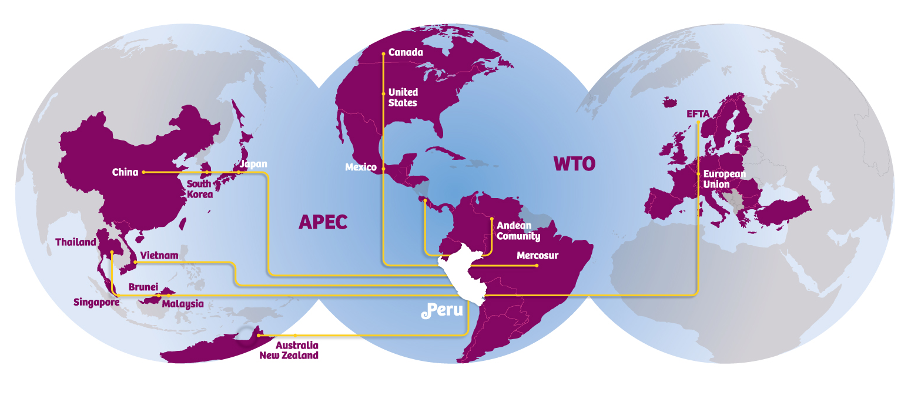
OPEN TRADE AND MARKET ACCESS POLICY
Working to become a globalized economy,
with preferential access to the world’s largest markets
These countries stand for enlarged market of over 4 billion people with a joint GDP over US$ 56 trillion 96% of Peruvian exports
Notes:
27
Un tercer factor de importancia a tomar en cuenta para evaluar al Perú con destino de inversiones es su activa política de integración comercial con el mundo.
A través de diversos esquemas de integración, se ha logrado el acceso a importantes mercados ampliados, hacia los cuales podrá acceder el inversionista que se establezca en el país. Ejemplo de ello son los Tratados de Libre Comercio suscritos con Estados Unidos, Canadá, Singapur y China, y el Acuerdo con Tailandia. Destacar que el tratado con Estados Unidos entró en plena vigencia el 1 de febrero de este año y se negocian otros tratados con la Unión Europea, EFTA y Corea.
El Perú es además miembro de la Comunidad Andina de Naciones y mantiene también preferencias arancelarias con la mayoría de los países latinoamericanos como México, Chile, Mercosur, etc.
Es meta del Perú convertirse en el principal hub de negocios o plataforma exportadora en la región del Pacífico Sudamericano.

Slide 28
INVESTMENT OPPORTUNITIES IN ATTRACTIVE SECTORS

Slide 29
AGRIBUSINESS SECTOR
Natural greenhouse.
High agricultural yields: Sugarcane (2nd), Asparagus, Olives (3rd), Artichokes (4th), Grapes (6th) and Avocado (11th).
Seasonal windows in major markets.
The 100,000 ha of land currently devoted to agricultural exports are expected to double as a result of large agricultural irrigation and expansion existing projects.
More than US$ 5.000 billion in exports of fresh and processed products to more than 150 countries.
Organic and Natural Products with high export potential.
Notes:
29
29
Dry tropics with vertical sunlight generates an artificial Greenhouse with adequate lighting and temperature difference during the day and night.
Best crop yields in the world:
Sugarcane (1st),
Asparagus, Olives and Artichokes (3rd),
Grapes (5th)
Access to "seasonal windows" in the most important markets with rewards on prices.
Irrigation projects will enable to expand the 90,000 ha dedicated to agro exports.
Majes Siguas: 38,000 Ha
Olmos: 35,000 Ha
Chavimochic: 20,000 Ha
More than US$ 2.500 billion in exports of fresh and processed products to more than 113 countries.
Leading world exporter of asparagus, organic coffee and organic bananas.
Products with high export potential: Andean grains (amaranth, quinoa and tarwi), exotic fruits (chirimoya, aguaje and camu camu), berries, avocado, among others.
Potential of Coastal land for agricultural exports:
Tumbes: 30,000/ Basic food crops.
Piura: 50,000/ ethanol
Lambayeque:38,000/ Ongoing private initiative.
La Libertad: 20,000/ Chavimochic for export
8,000/ Export
10,000
Arequipa: 38,000/Majes II
8,000/Majes I
Total: 202,000

Slide 30
AGRIBUSINESS SECTOR
Agricultural exports
according to Target Market – 2015
Source: ADEX Data Trade., BCRP.
Notes:
Tradicionales – Traditional
No Tradicionales – Non-traditional
Alemania – Germany
Países Bajos – The Netherlands
España – Spain
Bélgica – Belgium
Reino Unido – United Kingdom
Francia – France
Otros - Others

Slide 31
MANUFACTURING INDUSTRY
In the last 10 years (2006- 2015) the sector has experimented an annual average growth of 4%, despite of the negative average variation of -2.6% in the past two years.
There are different causes, among them we can emphasize the international situation and the drastic reduction on the capture of hydro biological species.
Significant recovery is estimated in the 2017, with 4% growth due the full capacity of mining projects and by the internal market dynamics at the beginning of several works of the large projects of infrastructure granted in concession in recent years
Notes:
Pima cotton use in the clothing industry sector, is a strategic differentiator for its extra-large and smooth strand, considered one of the most quoted and thin strands of the world.
Leading producer of the finest fibers of South American camelids: alpaca and vicuña, superior to the cashmere fiber.
Extensive textile tradition, promotes professionalism and training of the workforce, for farming activities and design and production processes.
International recognition as "full package" supplier of the best brands in the world of knitted cotton fabric.
Strong growth trend in exports, reaching its highest level in 2008: US$ 2,000 Million.
Brands served by Peruvian industries:
Abercrombie & Fitch; Izod Ara Intersales; JC Penny; Armani Exchange;
Nassino Dutti; Calvin Klein; Nautica Donna Karan Inc.; New Balance;
DKNY; Lacoste; Duck Head; Appared Co.; Kenneth Cole; Eddie Bauer;
Levy Strauss and Co.; Guess; Oakley; Inditex/Zara; Palacio de Hierro;
Polo Ralph Lauren; Ragman; Perry Ellis; International Reebok;
The Gymboree Corp.; Vanity Fair; Tommy Hilfiger; Saks Inc.

Slide 32
MANUFACTURING INDUSTRY
Source: ASOCEM , PRODUCE

Slide 33
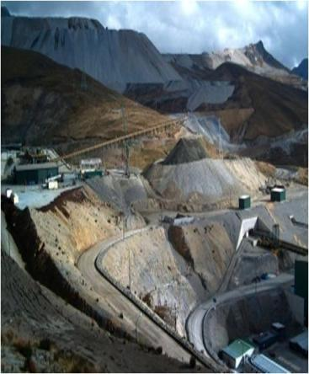
MINING SECTOR
Polymetallic country
13.61% of the land is subject to mining concessions, and only 1.25% of the land is taken for mining exploration and exploitation.
In the world: Third producer of copper, silver, tin and zinc worldwide. In Latin America: First producer of gold, zinc, tin and lead. And 2nd of copper, silver and molybdenum.
In 2015, investment in mining reached a value of US$ 6,777 million.
Peru is one of the few countries in the world with non-metallic mineral deposits, including diatomite, bentonite, limestone and phosphate.
Notes:
En el 2015 la inversión minera alcanzó un valor de US$ 6777 millones.

Slide 34
MINING SECTOR
*Exports January to May 2016 Source: MINEM. Mining Statistical Bulletin May 2016
Elaborated by: ProInversión
** acumulated investment January to May 2016 Source: MINEM. Statistical Bulletin of Mining. May 2016
Elaborated by: ProInversión

Slide 35
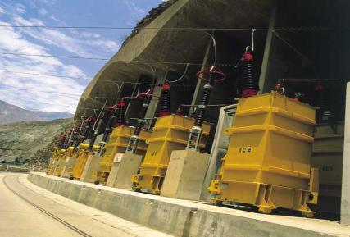
ENERGY SECTOR
Great energy potential: The wide availability of water resources and natural gas has enabled to meet the growing electricity demand in the country.
In 2015, 91% of the population had access to electricity.
Resources to be discovered and exploited: There are other renewable energy sources to be explored such as solar, wind, biomass and geothermal sources.
Energy production has grown 88% in the past 10 years. In 2015, the thermal generation represents 49.79%, while hydro energy 48.48%, wind energy 1,25% and solar energy 0.48%.
The main economic groups of power generation are: Enersur, Edegel, ElectroPerú, Transmantaro, REP, Luz del Sur, Edelnor, Hidrandina and Electro Dunas.

Slide 36
ENERGY SECTOR
/P: Preliminary
Source: MINEM. EVOLUTION OF THE ENERGY SECTOR INDICATORS 1995 - 2015

Slide 37
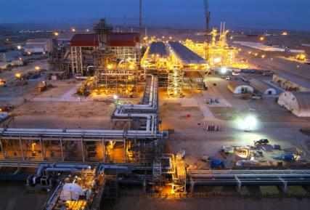
HYDROCARBONS SECTOR
The hydrocarbons sector growth begins between 2004 -2005 once the major natural gas reserve, located near to Camisea rivers, start its production activities (Camisea project).
Peru is the most important sustainable source of natural gas in the South American Pacific.
As to 12.31.2015 the proven reserves of natural gas reaches to 14,09 TCF, and the prospective resources of natural gas to 60,24 TCF.
For 2025 the estimated demand of natural gas is between 1900 MCF and 2400 MCF, this comprises the final consumption, petrochemical and electricity generation.
Peru has oil fields that have not been explored (29.97 million ha), making it a potential petrochemical hub.
The petrochemical industry is integrated with the production of natural gas and other liquid hydrocarbons, creating a significant added value.

Slide 38
PETROCHEMICAL SECTOR
Source: MINEM. Reserves books of 2015
Elaborated by Proinversion
Notes:
Úrea – Urea
Nitrato de Amonio para uso minero – Ammonium nitrate for mining use
Nitrato de Amonio para los demás usos – Ammonium nitrate for other uses
Sulfato de Amonio – Ammonium sulphate
Nitrato de Amonio para uso agrícola - Ammonium nitrate for agricultural use

Slide 39
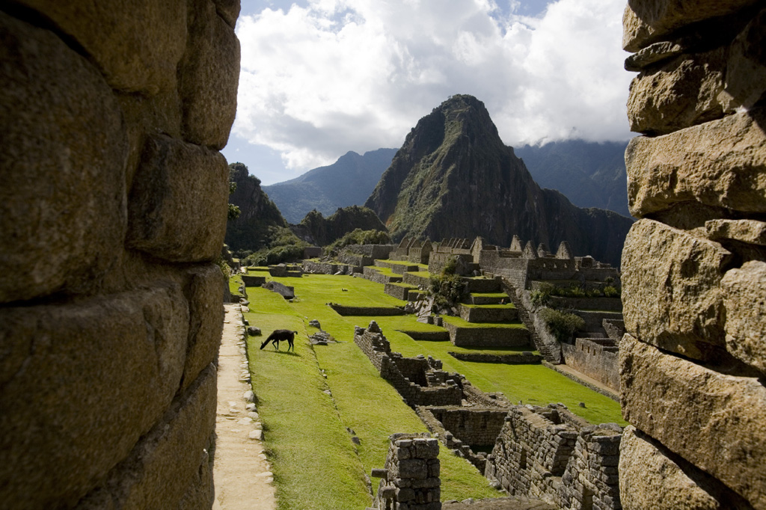
TOURISM SECTOR
Important cultural destination for archaeological sites of the Inca and pre-Inca cultures.
Machu Picchu was voted one of the New 7 Wonders of the World.
Diversity of natural settings. Destination for bird and orchid watchers.
Important investment by internationally renowned hotel chains.
The conventions and gastronomic tourism has gained a significant boost, Lima is considered as one of the main venues for this international venues and the gastronomic capital of Latin America.
Increased connectivity of the Peruvian air market with increased weekly frequencies in international flights to allow more connections and destinations, with more and better travel options.
Investment Opportunities in the 8 priority destinations: Northern Beaches, Amazon River, Amazonas, Kuelap, Moche Route, Lima, Nazca, Paracas, Colca Valley and Puno-Lake Titicaca.
Notes:
39
39
Important cultural destination for archaeological sites of the Inca and pre-Inca cultures.
Machu Picchu was voted one of the New 7 Wonders of the World.
Diversity of natural settings ranging from the beaches in the Pacific Coast to the Amazon Rainforest, through the Andes with peaks over 6,000 masl.
Essential destination for bird and orchid watchers, in which 1,730 bird species and more than 3,000 species of orchids live.
Lima is the gastronomic capital of Latin America with an offer of more than 10,000 restaurants that reflect the cultural diversity of the nation.
Significant investment of Hotels: Western, Hilton, among others.
Unexplored tourist attractions: Northeast Tourist Circuit: Kuelap, Sipan, Chan Chan, among others

Slide 40
TOURISM SECTOR
Tourist arrival per region
of origin – 2015*
Source: MINCETUR
(*)from the main 70 countries
Notes:
América del Norte – North America
Europa - Europe
América Central Central America
Oceanía - Oceania
África - Africa
América del Sur – South America

Slide 41
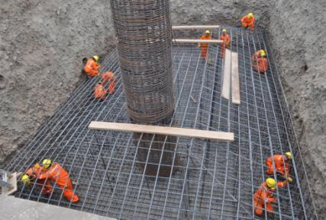
REAL ESTATE
The average GDP growth in the construction in the past 5 years was 4.6%.
The slowdown in the economy reduced the demand in properties that were registered until 2013. Nevertheless in the past year the largest investment of the sector were directed to the construction of shopping centers and important infrastructure projects.
In order to facilitate the access to a property – nationwide – the Ministry of Housing and Construction has implemented the following Programs and Products:
Leasing
Real estate leasing
New Credit My Housing Fund
My Construction
My materials
Own Roof
Bonus structural reinforcement

Slide 42
REAL ESTATE
Main Characteristics
of cement - 2015
Concept | Units (MTm)
Consumption | 10,852
Production | 10,410
Exports | 363
Installed capacity | 15,080
Source: ASOCEM- Association of Cement Producers
(*) Includes loans in soles and dollars
Source: Superintendency of Banks and Insurance
Notes:
Déficit Cualitativo - Qualitative Deficit
Déficit Cuantitativo - Quantitative Deficit

Slide 43
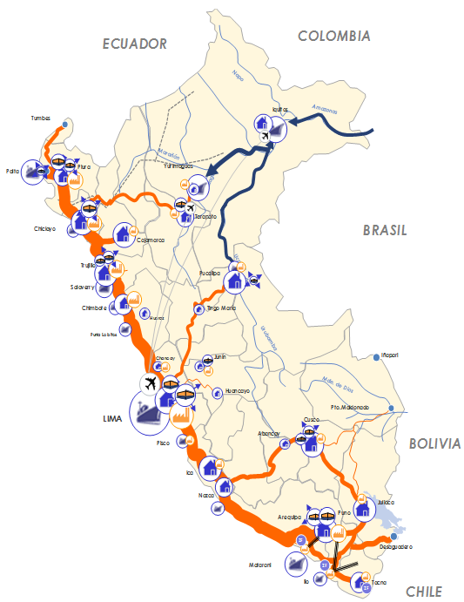
TRANSPORT INFRASTRUCTURE
Peru has prioritized the development of transport infrastructure (road, rail, port and airport) to increase competitiveness and set a Regional Hub that integrates Latin America with the Asia - Pacific.
In this perspective the investment commitments in concessions of the sector, in 31 projects are around US$ 14.1 billion, creating its modernization.
The sector will keep its expansion during 2016 through PPP projects, prioritized by the MTC; with additional investment commitments around US$ 10.440 million.
This new investment cycle represents significant opportunities for investors including contractors, suppliers and operators.
INFRAESTRUCTURA DE TRANSITO
Puerto marítimo/Fluvial
Aeropuerto
CENTRO DE PRODUCCIÓN, DISTRIBUCIÓN Y CONSUMO
Centro de acopio
Principal centro de consumo
Principal centro de producción
Centro de distribución / almacenaje
Notes:
43
43
Important cultural destination for archaeological sites of Inca and Pre-Inca cultures.
Machu Picchu was voted one of the New 7 Wonders of the World.
Diversity of natural settings ranging from beaches on the Pacific Coast to the Amazon Rainforest, passing through the Andes with peaks above 6,000 above sea level.
Must-see destination for birdwatchers and orchid aficionados. 1,730 bird species and more than 3,000 species of orchids inhabit the country.
Lima is the gastronomic capital of Latin America, offering more than 10,000 restaurants that reflect the cultural diversity of the nation.
Significant investment of Hotels: Western, Hilton, amongst others.
Unexplored attractions: Northeast Tourist Circuit: Kuelap, Sipan, Chan Chan, amongst others

Slide 44
TRANSPORT INFRASTRUCTURE
New Investments in Transport Infrastructure
Programmed for 2016-2017 (1)
Transport infrastructure | Investment amount (US$ million)
Road infrastructure: Longitudinal de La Sierra ,Section 4, Section Sullana – Ecuador; Longitudinal de La Sierra, Section 5 ⁽²⁾; Panamericana Sur, Ica, Detour Quilca; Peripheral ring road of Lima; Corridor Económico Central. | 2, 796
Railway infrastructure: Line 3 of Metro of Lima ⁽³⁾; Huancayo –Huancavelica Railway | 10,220
Port infrastructure: San Juan de Marcona, Pucallpa, Iquitos. Salaverry, Ilo, Chimbote ⁽⁴⁾ | 600
Waterways: Ríos Huallaga, Marañón, Ucayali y Amazonas, | 70
Logistic Platforms: Logistics Platform and Pre-Gate Parking & Service Center– Callao | 186
US$ Total MM | US$ 13,872
(1)Referential investment amount subject to variation (2) final investment amount of Project Longitudinal de la sierra, section 5; and other unsolicited proposals, to be defined. (3) estimated figures based on the investment amount of Line 2 of Metro of Lima, granted in concession in March 2014 (4)Estimated investment amount of unsolicited proposals.
Source: MTC, APN and Proinversion.
Notes:
New investment foreseen in transport infrastructure to 2016

Slide 45
www.proinversion.gob.pe
contact@proinversion.gob.pe
Notes:
45

